Slide 1
INTERNATIONAL TELECOM UNIT (ITU) RECOMMENDATION
Organisation of the work of ITU-T

Slide 2
Group Members
Vedant Athavale (181090071)
Dhruv Singh (181090064)
Tejas Adhikari (181090068)
Aditi Patil (181091003)
Rajkumar Shee (181090056)
Deep Vora (181090072)
Prathmesh Shinde(181090058)

Slide 3
Topics to be Covered
Study groups and their relevant groups
Study group management
Submission and processing of contributions
Joint coordination activities

Slide 4
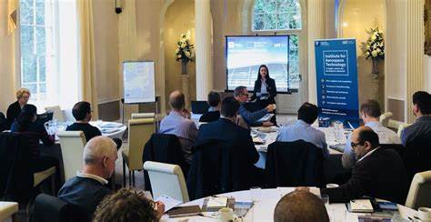
Frequency of meetings
Study groups meet to facilitate the approval of Recommendations only approval of the Director of the Telecommunication Standardization Bureau (TSB).
Meetings should not be held more frequently than is necessary to make effective progress and should take into account TSB's capabilities to provide the necessary documentation.

Slide 5
The arrangement and timing of the meeting should enable the study groups to exchange any information they may require without delay and enable the specialists concerned to avoid leaving their home countries too often.
The timetable of meetings shall be prepared and communicated to participating bodies well in advance (one year), thus, to make meetings more efficient and reduce their length.
Subject to physical and budgetary limitations and in consultation with the Director, the work of the study groups should be on a continuous basis.

Slide 6

Coordination of work
A joint coordination activity (JCA) may be formed to coordinate work relating to more than one study group. Its primary role is to harmonize planned work effort in terms of subject matter, time-frames for meetings and publication goals

Slide 7
Preparation of studies and meetings
At the beginning of each study period, an organization proposal and an action plan for the study period shall be prepared by each study group chairman with the help of TSB.
Individuals who attend the meeting without preregistration may experience a delay in receiving their documents.
If an insufficient number of contributions or notification of contributions has been submitted, no meeting should be held. The decision whether to cancel a meeting or not shall be taken by the Director.

Slide 8
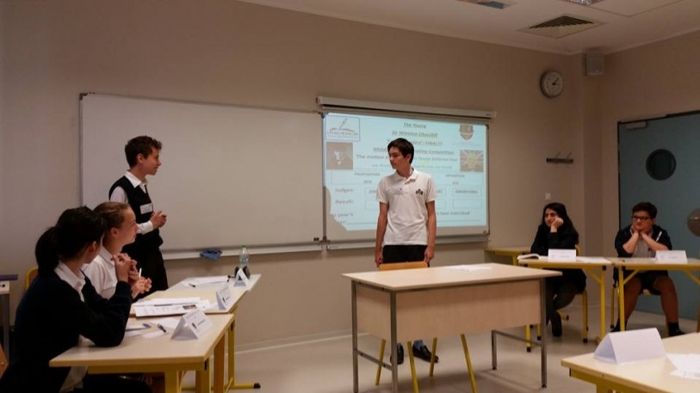
Conduct of meetings
The chairman shall direct the debates during the meeting, with the assistance of TSB.
Questions which have not elicited any contributions should not be placed on the final agenda of the meeting.
Study groups and working parties may set up ad hoc groups to study Questions allocated to those study groups and working parties.

Slide 9
For projects involving more than one study group, baseline documents may be prepared in order to provide the basis for coordinated study among the various study groups.
Chairmen will ask, during each meeting, whether anyone has knowledge of intellectual property rights issues, including patents, copyright for software or text, marks, the use of which may be required to implement or publish the Recommendation being considered.
The decision to add a new work item to the work programme shall be documented in the report of the meeting using the template in Annex A. Note that this may not be necessary to document th

Slide 10

Liaison statements

Slide 11
The following information shall be included in outgoing liaison statements:
List the appropriate Question numbers of the originating and destination study groups.
Identify the study group, working party or rapporteur group meeting at which the liaison statement was prepared.
Include a concise title appropriate to the subject matter.
Indicate the level of approval

Slide 12
The following information shall be included in outgoing liaison statements:
Indicate if the liaison statement is sent for action or comment or information
If action is requested, indicate the date by which a reply is required.
Include the name and address of the contact person.
Identify the study groups and working parties or other standards organizations to which it has been sent.

Slide 13

Regulations
Liaison statements should be forwarded to the appropriate destinations as soon after the meeting as possible
Copies of all liaison statements should also be sent to the chairmen of the study groups and working parties involved for information and to TSB for processing.

Slide 14

Correspondence activities
A correspondence activity on a particular topic may be authorized to be conducted via e-mail between meetings.
Each correspondence activity should have specified terms of reference.
A convener is appointed to moderate the e-mail discussion and prepare a report to a subsequent meeting.
A correspondence activity should normally conclude no later than the contribution deadline of the meeting to which it is expected to report

Slide 15
Preparation of reports:
A report on the work done during a meeting shall be prepared by TSB.
This report should set out the results of the meeting and the agreements reached in a condensed form and should identify the points left to the next meeting for further study.
The number of annexes to the report should be kept to a strict minimum by means of cross-references to contributions and reports, references to material in the documentation of a study group or working party.

Slide 16

Preparation of reports:
The report should concisely present the following:
organization of work;
references to ,and
possible summary of contributions or documents issued during a meeting;
main results, including status of new or revised Recommendations;

Slide 17
Preparation of reports:
The report should concisely present the following:
directive for future work;
planned meetings of working parties, sub-working parties and rapporteur groups; and
condensed liaison statements endorsed at the study group or working party level. The table showing the status of Recommendations from the report is used to update the work programme database

Slide 18

Additional Info
To assist TSB in this task, the study group or working party may arrange for delegates to draft some parts of the report. TSB should coordinate this drafting work.
If necessary, the meeting will set up an editorial group to improve the texts of draft Recommendations in the official languages of the Union

Slide 19

If possible, the report shall be submitted for approval before the end of the meeting; otherwise, it shall be submitted to the chairman of the meeting for approval.
Individual reports of meetings should be accessible online to appropriate users as soon as electronic versions of these documents are available to TSB (Telecommunication Standardization Bureau).

Slide 20

When existing and already translated ITU-T texts have been used for some parts of the report, a copy of the report annotated with references to the original sources should also be sent to TSB. If the report contains ITU-T figures, the ITU-T reference number should not be deleted even if the figure has been modified.
The report of a study group's first meeting in the study period shall include a list of all the rapporteurs appointed. This list shall be updated, as required, in subsequent reports.

Slide 21

Definitions
Terms defined elsewhere:
Describes procedures and defines terms related to non-normative publications
This Recommendation uses the following term defined elsewhere:
Question: Description of an area of work to be studied, normally leading to the production of one or more new or revised Recommendations.

Slide 22

Terms defined in this Recommendation
Amendment: Changes or additions to an already published ITU-T Recommendation.
Annex: Material (e.g., technical detail or explanation) that is necessary to the overall completeness and comprehensibility of a Recommendation, and is therefore considered an integral part of the Recommendation.

Slide 23

Appendix: Material that is supplementary to and associated with the subject matter of a Recommendation but is not essential to its completeness or comprehensibility.
Clause: Single-digit or multiple-digit numbered text passages.
Corrigendum: Corrections to an already published ITU-T Recommendation.
Erratum: Corrections of publication and editorial errors in an already published ITU-T Recommendation. An erratum is published by TSB with the concurrence of the study group Chairman, in consultation with other relevant parties.

Slide 24

Normative reference: The whole or parts of another document where the referenced document contains provisions which, through reference to it, constitute provisions to the referring document.
Text: The "text" of Recommendations may contain printed or coded text and/or data (such as test images, graphics, software, etc.).

Slide 25

Work item: An assigned piece of work, which is identifiable with a Question and which has specific or general objectives, which will result in a product, such as a Recommendation, for publication by ITU-T.
Work programme: A list of work items that are owned by a study group.

Slide 26

Study group management

Slide 27

Study group structure
Study group chairmen shall be responsible for the establishment of an appropriate structure for the distribution of work and the selection of an appropriate team for working party .
A study group may entrust a Question, a group of Questions within its general area of responsibility to a working party.
Where the scope of the work is considerable, a study group may decide to further divide the tasks assigned to a working party to sub-working parties.
Working parties and sub-working parties should be set up only after thorough consideration of the Questions. Proliferation of working parties, sub-working parties or any other subgroups should be avoided.

Slide 28
Distribution of work
A study group may exceptionally, by agreement with other relevant study group(s) entrust a joint working party with Questions or parts of Questions of common interest to the study groups concerned.
This study group shall act as the parent study group for the joint working party and shall coordinate and have responsibility for the work concerned.
The contributions used as a basis for discussion in the joint working party shall be sent exclusively to those registered in the joint working party. Only the reports shall be sent to all participating bodies of the study groups concerned.
Two or more study groups may decide to progress work on topics of common interest through joint meetings of their rapporteur groups.
As the promotion of study group activities is an essential element in any ITU-T marketing plan, each study group chairman, supported by other study group leaders and subject matter experts, is encouraged to establish, maintain and participate in a promotion plans.

Slide 29

Joint coordination activities
A joint coordination activity (JCA) is a tool for management of the work programme of ITU-T .
A JCA may help to coordinate the planned work effort in terms of subject matter, time-frames for meetings, collocated meetings where necessary and publication goals including, where appropriate, release planning of the resulting Recommendations.
The establishment of a JCA aims mainly at improving coordination and planning.
JCAs may submit proposals to the relevant study groups to achieve alignment in the development of related Recommendations and other deliverables by the respective study groups..

Slide 30
Joint Coordination activities
Any group may propose that a JCA be established. The proposal to establish a JCA should first be discussed within the proposing group's management team, then among the relevant study group chairmen and the TSAG chairman. Discussions may be held with external SDOs and forum leaders .
A JCA may identify technical and strategic issues within the scope of its coordination role, but will not perform technical studies nor write Recommendations.
A JCA may be terminated at any time if the involved study groups agree that the JCA is no longer required.

Slide 31

The roles of rapporteurs
Rapporteurs is a person who is appointed by an organization to report on the proceedings of its meetings.
Rapporteurs may be appointed at any time with the agreement of the working party, or of the study group, where the Question(s) are not allocated to a working party.
A rapporteur may propose the appointment of one or more associate rapporteurs, whose appointments should then be endorsed by the relevant working party (or study group).
Rapporteurs, and their associate as well as the editors, play an indispensable role in coordinating increasingly detailed and often highly technical study.
Consequently, their appointment should be primarily based on their expertise in the subject to be studied.

Slide 32
The rapporteur's responsibilities are:
To coordinate the detailed study in accordance with guidelines established at working party.
To the extent authorized by the study group, to act as a contact point and source of expertise with other ITU-T, ITU Radiocommunication Sector (ITU-R) and ITU TelecommunicationDevelopment Sector (ITU-D) study groups.
To adopt methods of work (including the use of the TSB EDH system, meetings of experts, etc.) as considered appropriate for the task.

Slide 33
To ensure that the parent working party (or study group) is kept well informed of the progress of the study
To submit a progress report to each of the parent group's meetings in the form of a TD to be submitted as soon as possible.
To review and update the work programme, which should be approved and reviewed periodically by the parent group.
To give the parent working party or study group and TSB adequate advance notice of the intention to hold any meetings of experts.

Slide 34
To establish a group of active "collaborators" from the working party (or study group) where appropriate, with an updated list of those collaborators being given to TSB at each working party meeting.
To delegate the relevant functions from the list above to associate rapporteurs and/or liaison rapporteurs, as necessary.

Slide 35
The basic goal of each rapporteur is to assist the study group or working party in developing new and revised Recommendations to meet changing requirements in telecommunication techniques and services. Rapporteurs should not feel under any obligation to produce such texts unless a thorough study of the Question reveals a clear need for them.
Rapporteurs are responsible for the quality of their texts, submitted by the study group for publication.
Rapporteurs should normally base any draft new or substantially revised Recommendations.
Rapporteurs must give advance notice of any meetings they arrange, not only to the collaborators on their Question or project, but also to the study group and working party.

Slide 36
TSB will post a convening letter for rapporteur group meetings normally at least two months prior to the meeting, on the study group webpage, as provided by the study group. Visa support should be provided by the meeting host.
Rapporteurs should prepare a meeting report for each rapporteur group meeting held and submit it as a TD to the next study group or working party meeting. Rapporteur group meetings, as such, should not be held during working party or study group meetings.

Slide 37
The parent working party (or study group) must define clear terms of reference for each rapporteur.
Meetings are arranged to be held outside ITU premises, participants should not be charged for meeting facilities .

Slide 38
Submission and processing of contributions
-An overview

Slide 39
Submission of contribution.
Member States and other duly authorized entities registered with a study group or its relevant group should submit their contributions to current studies via electronic means, in accordance with guidance from the Director of TSB (Trusted Saving Bank)

Slide 40
Okay……. So What exactly is a study group???
When a proposal comes before a Sponsor concerning a standards development project, the Sponsor may form a Study Group to examine the proposal.
Study Groups are formed when enough interest has been identified in a particular area.

Slide 41
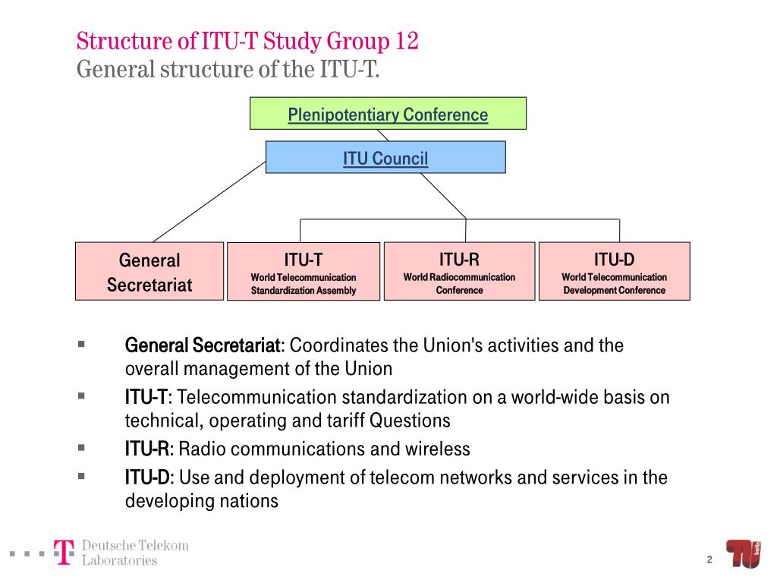

Slide 42
Contributors are reminded, when submitting contributions, that early disclosure of patent information is desired, as contained in the statement on Common Patent Policy.
Patent declarations are to be made using the “Patent Statement and Licensing Declaration Form” which are available at the ITD website.

Slide 43
By making a contribution, contributors acknowledge, to the best of their knowledge, that material such as text, diagrams, etc., submitted as their contribution to the work has no restriction in order to permit the normal distribution of this material for discussions.
If a contribution proposes to make normative reference to, or to incorporate text, diagrams, etc. from a document from a source qualified, the source document should be clearly identified in the contribution for reference in case the study group reaches consensus on such a proposal.

Slide 44
The full text of contributions that are to be considered at a study group or working party meeting or any software copyright statement shall reach TSB at least 12 calendar days before the meeting.

Slide 45
Processing of contributions
Contributions received at least two months before a meeting may be translated and will be posted in the original and, if applicable, in translated languages, on the web as soon as practicable after they are received. They will be printed and distributed at the beginning of the meeting only to the participants present who request paper copies.

Slide 46
Contributions should be posted on the web no more than three working days after they are received by the secretariat.
Contributions received by the Director less than 12 calendar days before the meeting will not appear on the agenda of the meeting, will not be distributed and will be held for the next meeting.

Slide 47
Contributions shall not be included in reports as annexes, but should be referenced as needed.
Contributions should, as far as possible, be submitted to a single study group. If, however, a member submits a contribution that it believes is of interest to several study groups, it should identify the study group primarily concerned; a single sheet giving the title of the contribution, its source and a summary of its contents will be issued to the other study groups by the member. This single sheet will be numbered in the series of contributions of each study group to which it is issued.

Slide 48
TDs
TDs should be provided to TSB in electronic format. TSB shall post electronically those TDs submitted as electronic files as soon as they become available; those submitted as paper copies will be posted as soon as practicable. Printed copies may be provided upon request to persons with disabilities and specific needs.
Extracts from reports of other study group meetings or from reports of chairmen, rapporteurs or drafting groups shall be published as TDs.
TDs input before the start of the study group or working party meeting, including documents from the ITU secretariat, should be posted on the relevant page of the website not later than three working days from the date on which they are received by the secretariat, to ensure their availability not later than seven calendar days before the start of the meeting.
This deadline shall not extend to administrative documents or reports on events that have taken place less than 21 calendar days before the start of the meeting, nor to proposals from chairmen and convenors of ad hoc groups, compilations of proposals prepared by chairmen or the secretariat, or documents specifically requested by the meeting.

Slide 49
TDs
Reports on events that have taken place less than 21 calendar days before the start of the meeting should normally be posted on the relevant page of the website not later than two calendar days before the beginning of the discussion of the item in question at the meeting, unless otherwise agreed by the meeting.
TDs can be produced during the meeting.
Chairmen and vice-chairmen of study groups and working parties may at any time submit inputs as TDs to their study group or working party, including, in particular, proposals likely to accelerate the debates.

Slide 50
Electronic access
TSB will post electronically all documents (e.g., contributions, TDs (including liaison statements)) as soon as electronic versions of these documents are available. Appropriate search facilities for posted documents should be provided

Slide 51
Other document types
As the work of the ITU-T and its groups progresses, various types of output materials might result, in addition to Recommendations and other texts previously described.
Other types of ITU-T documents include non-WTSA proceedings (e.g., Kaleidoscope), tutorials, e-learning and web-based guides. These document types do not require agreement by a study group and do not have working methods described by an A-series Recommendation.

Slide 52
Other ITU-T groups

Slide 53
Focus group (FG)
The objective of focus groups is to help advance the work of the ITU Telecommunication Standardization Sector (ITU-T) study groups and to encourage the participation of members of other standards organizations, including experts and individuals who may not be members of ITU.
Focus group activities may include an analysis of gaps between current Recommendations and expected Recommendations, and provide material for consideration in the development of Recommendations.

Slide 54
Intersector Rapporteur Group (IRG)
Intersector Rapporteur Groups (IRGs) are established to coordinate the progress of specific topics of mutual interest between sectors of the ITU. For a given topic, IRGs encourage the collaboration between ITU-T study groups and groups from other ITU sectors on work items unique to each study group.

Slide 55
Joint Coordination Activity (JCA)
A Joint Coordination Activity (JCA) is formed to coordinate activities on topics of relevance across ITU-T Study Groups. They report their progress either to TSAG or to a particular study group.
Where FGs are typically formed to study forward-looking topics, report results, and dissolve, JCAs are envisioned as tools for coordination between study groups. Like FGs, JCAs do not write Recommendations.

Slide 56
ITU-T group types for collaborating with other SDOs
Several groups within ITU-T have been formed to support joint efforts between ITU-T and other standards development organizations (SDOs) on the development of common or aligned specifications or standards.
The working methods of these groups vary, as does the documentation regarding how new instances of such groups are formed.
In some cases, such groups seek to align the timing by which standards development progresses through two processes, such as ITU-T and another SDO.
In other cases, participation in the collaborative effort is not limited to a specific SDO.

Slide 57
Additional ITU-T groups
In addition to the group types documented above, additional groups exist that operate with working methods distinct from those documented above. TSAG and study groups should terminate inactive groups.

Slide 58
Joint coordination activities
A joint coordination activity (JCA) is a tool for management of the work programme of ITU-T when there is a need to address a broad subject covering the area of competence of more than one study group.
A JCA may help to coordinate the planned work effort in terms of subject matter, time-frames for meetings, collocated meetings where necessary and publication goals including, where appropriate, release planning of the resulting Recommendations.
The establishment of a JCA aims mainly at improving coordination and planning. The work itself will continue to be conducted by the relevant study groups and the results are subject to the normal approval processes within each study group.

Slide 59
Joint coordination activities
A JCA may identify technical and strategic issues within the scope of its coordination role, but will not perform technical studies nor write Recommendations.
A JCA may also address coordination of activities with recognized standards development organizations (SDOs) and forums, including periodic discussion of work plans and schedules of deliverables.
The study groups take JCA suggestions into consideration as they carry out their work.

Slide 60
General Principles under ITU-T Regulations

Slide 61
Environmental impacts categories
Several categories of assessments of environmental impacts may be performed in the field of ICT.
The following common categories are:-
• Global warming potential | • Energy consumption
• Water depletion | • Raw material depletion
• Ozone depletion | • Air toxic emissions
• Photochemical ozone creation | • Air acidification
• Water eutrophication | • Water toxic emissions and Hazardous waste generation.

Slide 62
Environmental load reduction by ICT
Environmental load reduction may come from, in particular, ICT dematerialization impact based on substituting higher carbon products and activities with ICT-enabled lower carbon alternatives.
These alternatives include:
Online media
E-ticketing
E-commerce
E-paper
Videoconferencing
Teleworking or other remote-participation service.

Slide 63
Environmental load possible reduction effects by using ICTs
Consumption of materials | By reducing material consumption, the environmental load related to goods production and disposal as well as waste generation can be reduced.
Power consumption/ energy use | By enhancing the efficiency of power and energy use to reduce consumption, the environmental load related to power can be reduced
Movement of people | By reducing the movement of people, the environmental load required for transportation can be reduced.
Movement of materials | By reducing the movement of materials, the environmental load required for transportation can be reduced.

Slide 64
Improved efficiency of office space | By using office space efficiently, power consumption for lighting, air conditioning, etc. can be reduced, thus reducing environmental load.
Storage of goods | By reducing storage space of goods, power consumption for lighting, air conditioning, etc. can be reduced, thus reducing environmental load.
Improved work efficiency | By enhancing work efficiency, the environmental load can be reduced.
Waste | By reducing waste emissions, the environmental load required for environmental preservation as well as for waste disposal can be reduced.

Slide 65
Thank YOU!!

